Slide 1
Operating Systems

Slide 2
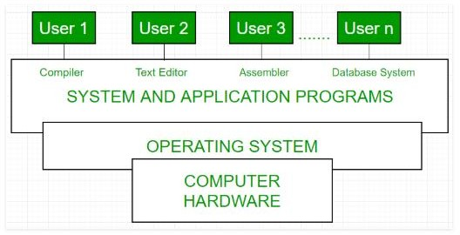
Operating Systems
It’s a software that allows a user to run other applications on a computing device and acts as an intermediary between a user of a computer and the computer hardware.

Slide 3
What do operating systems do?
Allocation of resources
Memory management.
User View
Extended machine that hides the lower level details
System View
Resource allocator
Resource
Component of limited availability necessary for effective operation.
A resource is whatever any process needs to use to complete its task.
Memory , CPU, files, printer, data or any I/O devices , anything that is needed to complete tasks.

Slide 4
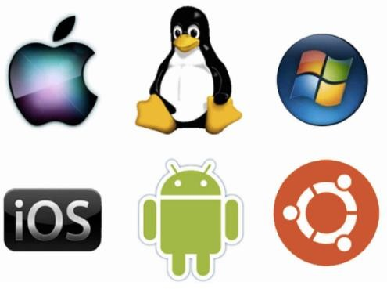
Examples of Operating Systems
Windows
Linux
Mac OS
Ubuntu
Android
iOS

Slide 5
Goals of Operating System
Operating System Goals
Execute user programs.
Make solving user problems easier.
Make the computer system convenient to use.
Use the computer hardware and resources in an efficient manner.

Slide 6
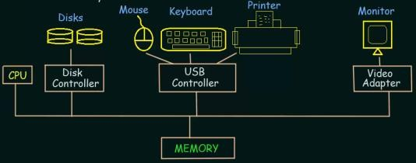
Computer System Operation
A modern general purpose computer consists of one or more CPUs and a number of device controllers connected through a common bus that provides access to a shared memory.

Slide 7
Each device controller is in charge of specific type of device.
The CPU and controllers can execute concurrently (at the same time )competing for memory cycles.
Memory controller synchronize access to the memory.

Slide 8
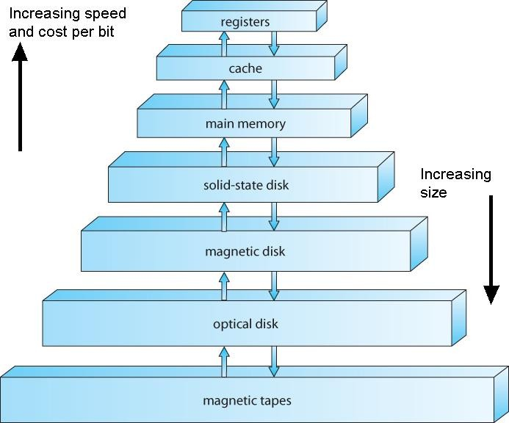
Storage Structure
Volatile:
Loses its contents when power is removed.
Non Volatile: Retain its contents even when power is removed.

Slide 9
Types of Operating System
Batch Operating System
Multitasking OS
Multiprogramming OS
Multiprocessing OS
Distributed OS

Slide 10
Batch Operating System
The users of a batch operating system do not interact with the computer directly.
Each user prepares his job on an off-line device like punch cards and submits it to the computer operator.
System will execute the jobs one by one.

Slide 11
Multiprogramming
The capability of running multiple programs by the CPU.
Multiprogramming increases the CPU utilization by organizing jobs (code and data) so that the CPU always has one to execute.
Main Memory (RAM)
Job 1
Job 2
Job 3
Job 4
0
512mb

Slide 12
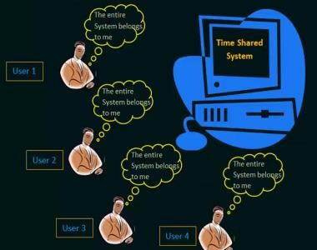
Multitasking (Time Sharing)
CPU executes multiple jobs by switching among them.
Very fast switching.
A time sharing operating system allows many users to share the computer simultaneously.

Slide 13
Multiprocessing
Multiprocessing is the use of two or more central processing units (CPUs) within a single computer system.
The term also refers to the ability of a system to support more than one processor or the ability to allocate tasks between them.

Slide 14
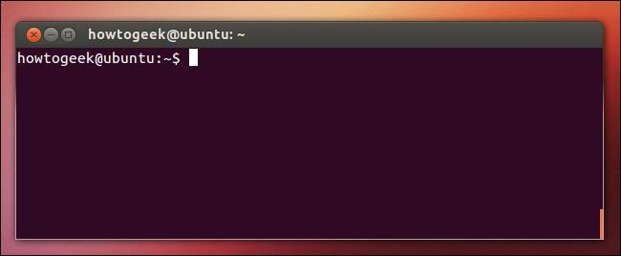
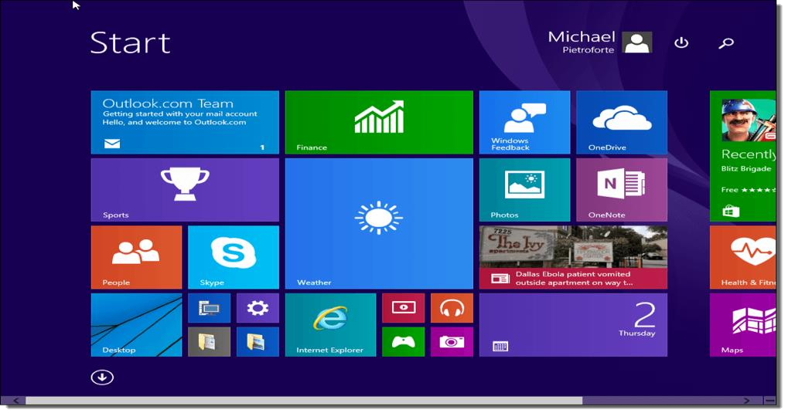
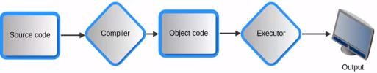
Operating System Services
User Interface
Allows the user to interact with the computer.
Command line interface (Terminal)
Graphical user interface
Program Execution
Load the program into memory
Execute the program.

Slide 15
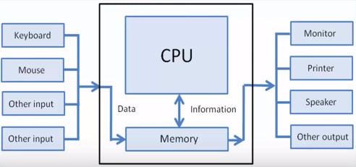
I/O Operations
File system manipulation
Creation, deletion, search
Resource Allocation

Slide 16
BIOS(Basic Input Output System
A firmware designed to be executed first when computer is turned on
Function Is to identify , test and initialize system devices like hard disk .
BIOS sets the machine in a state so that the operating system can be loaded , executed and given control of a PC.

Slide 17
Important Terms and Definitions
Bootloader
Called by BIOS
Initializes the OS during start up.
It is stored in the ROM.
It must know how to load the OS and start executing that system.
It must locate and load OS kernel into memory.
Process
In computing, a process is an instance of a computer program that is being executed. It contains the program code and its activity.
Kernel
A kernel is the central part of an operating system.

